Slide 1











Lending Opportunity
Bic Vu
AI Guild Apprentice Program Capstone
Cohort 11 June 2023

Slide 2
Can you buy into better opportunities?
PROBLEM STATEMENT
Proposed Solution
Analyze the potential correlations between Social capital features along with standard economic inputs from CFPB’s Home Mortgage Disclosure Act (HMDA) data for the location of the property.
Build and test models that predict the probability of a home approval.
Social capital — “the strength of our relationships and communities” — has been identified as a determinant of upward mobility. A study on social captital¹ showed that “living in a place that fosters these connections causes better economic outcomes.”
When people are looking to buy a home, especially as a family, they consider the opportunities of that location. But what if the existing social capital network of that location has an impact on the likelihood of their home loan getting approved? How does the existing economic connectedness, cohesiveness and civic engagement of a location impact a potential home buyer’s ability to access opportunities?
Impact
Beyond standard characteristics of a neighborhood such as schools and amenities that makes a home appealing, potential lenders could also consider the location of the home as an opportunity to access a better social capital network.
Chetty, Jackson, Kuchler, Stroebel, et al. Nature 2022

Slide 3
Analytics Pathway
Data research & sourcing
Exploraroty data analysis & feature engineering
Identified the most interesting and relevant data sets to address challenge.
Researched challenge topic
Reviewed data volume and source data methodology
Discovered patterns, spotted anomolies and checked assumptions through feature engineering.
Cleaned and normalized data
Merged on geographic identifiers
Visualized relationships (correlation matrix, scatterplots)
Process from initial research, exploratory data analysis to model development and tuning.
Hyperparameter tuning
Model selection
Adjusted hyperparameters to improve model performance based on previous RMSE.
XGBoost
Ray Tune
Tested regression model for baseline analysis.
Split data
Trained on XGBoost
Validated and fit model
Explained feature importance using SHAP
Improve performance
Draw Conclusion
Automate model testing for incremental improvement.
AutoGluon

Slide 4


About the Data
ETL & EDA
Research and exploratory data analyses.
HMDA
Economic metrics
Loan approval
Income
Debt to income
Loan amount
Property value
Socio-geographic metrics
Race
Minority population
Census tract income level
What makes this data interesting? People!
The Consumer Financial Protection Bureau’s (CFPB) Home Mortgage Disclosure Act (HMDA) data contains financial statistics about people, such as debt to income ratio, that directly impacts a loan appraisal, along with potentially influencing statistics such as race and percentage of minority population in the census tract.
The Social Capital data measures economics opportunities of by using Facebook data to determine metrics such as the ratio of high and low income friends in a community.
By linking the location of a home loan with the economic opportunity of that geographic area, the study aims to observe correlations between a community’s social connectivity and opportunity to buy into that community.
Merged on Census tracts
Social Capital
Economic metrics
Economic connectedness
Exposure to high income individuals
Socio-geographic metrics
Clustering of friends
Volunteering rate
Civic organizations
Converted zip to Census tracts
Reference data dictionary in appendix section
Notes:
What are the data sources? Why are they interesting? Why are they relevant to this problem?
Highlight a few features. Whate features are interesting? What features did you create? What is the target?
Data preprocessing: Analyze and select features. Create and normalize categorical data. Convert to same geographic identifie for merging.
Process diagram
Screenshot of feature statistics
EDA findings:
Correlation matrix
A few scatter plots
EDA leads to model selection: regression

Slide 5
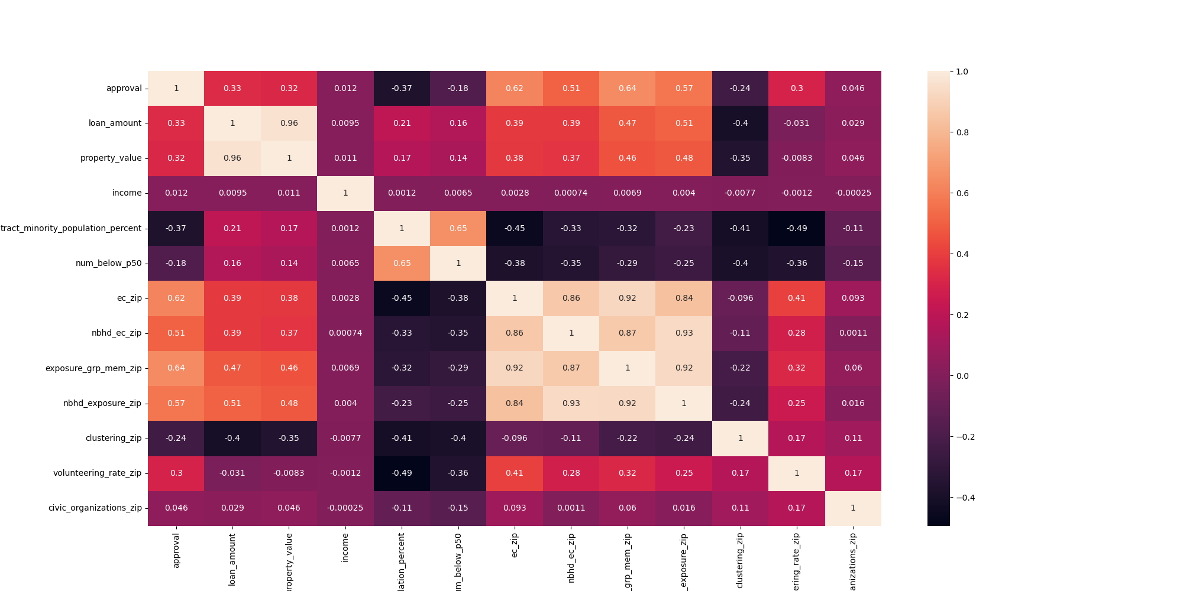
Features Correlation
EXPLORATORY DATA ANALYSIS
Analyzing relationships
The correlation matrix reveals that there are highly positive linkage between economic connectedness and exposure metrics in the Social Capital data with the approval rate for home loans in the HMDA data.
Secondary high correlations exists between exposure and loan amount and property value
Other relationship were minimal or negative. Particularly negative was the low level economic connectedness with tracts where a large percentage of the population is minority.
Similarly negative is the correlation between voluntering rate and minority population, indicating that there is perhaps a low rate of volunteering in Census tracts where there is a high minority population.
Social Capital
TARGET: approval
loan_ amount
property _value
income
tract_minority _population _percent
HMDA

Slide 6
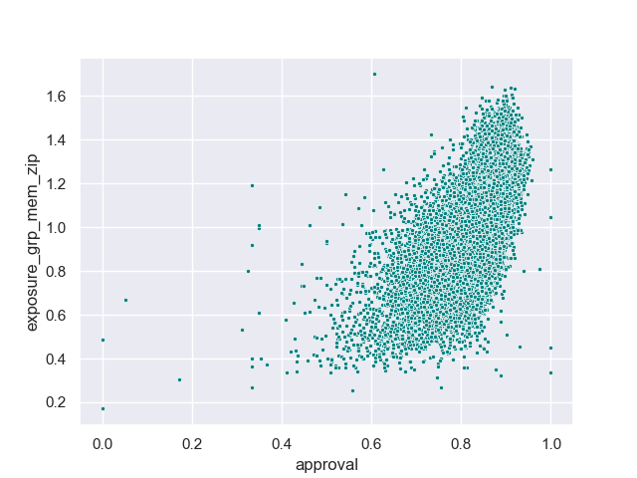
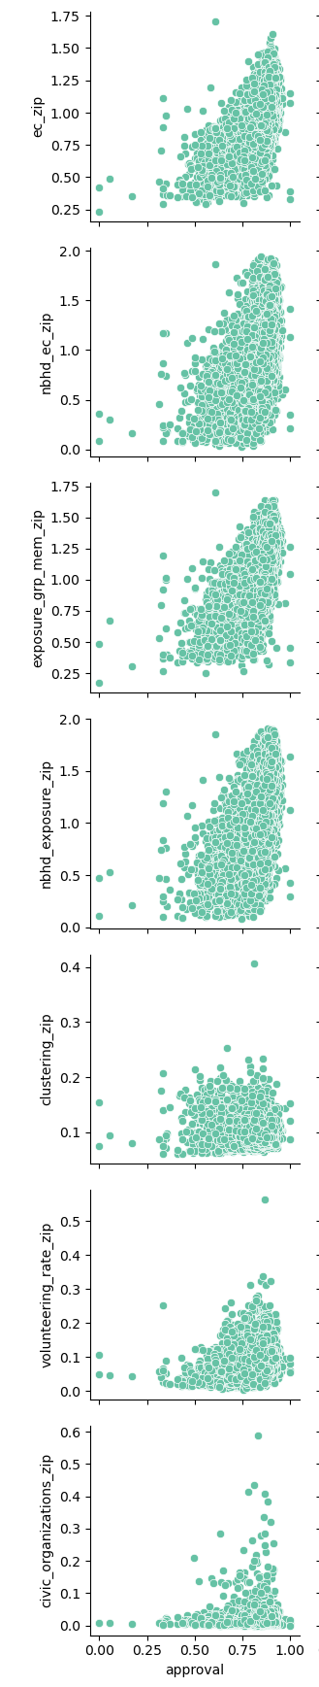
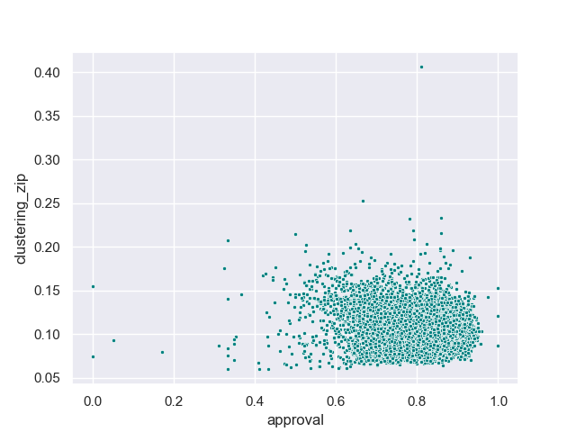
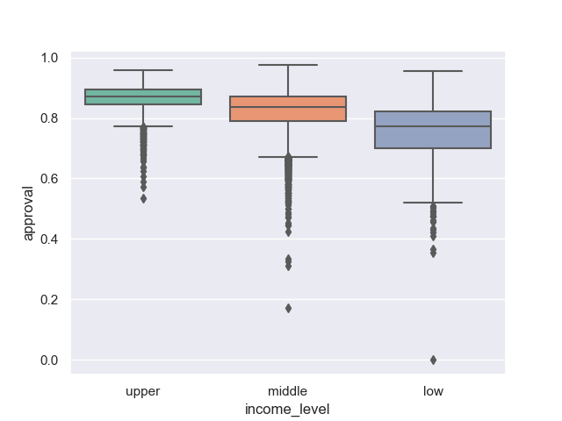
Scatter Plot of Key Features
EXPLORATORY DATA ANALYSIS
Distribution of Correlations
Scatterplots were used to visually observe patterns in relationships of features with highest and lowest correlations compared to the target.
Additionally box splots were used to reference check categorical features, such as income level of Census tracts.
The various non-linear patterns of distribution shown in the scatterplots comparing target to features makes this data set a candidate for a regression model.
Scatterplot of highest positive correlation feature (exposure to high income friends) with target (loan approval)
Feature sample (Social Capital)
Scatterplot of lowest negative correlation feature (clustering) with target (loan approval)
Box plot of income level for Census tracts compared to loan approval
Target (loan approval)

Slide 7
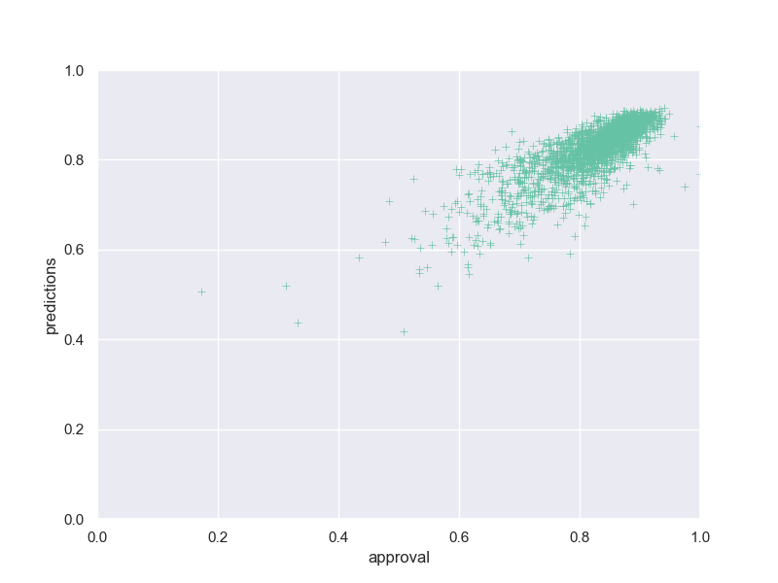
XGBoost Regressor
Data split for all models
MODEL 1
Train
70%
9,979 rows (one Census tract per row)
Validate
15%
2,139 rows
Test
15%
2,138 rows
Model Selection
The EDA process indicated that there are non-linear patterns in the data which makes this challenge a candidate for a regression model. (The target metric of loan approval is also a continuous probability ranging 0 to 1, which rules out classification.)
An XGBoost regressor was selected for the initial model because of options for early stopping to avoid overfit. Results were fairly accurate, particularly predictions for approal rates above 80%.
Actuals vs Predictions
Model Type | XGBoost Regressor
Key model adjustments | n_estimator = 300 max_depth = 6 early_stopping_rounds = 10
Best validation RMSE | 0.04720
Prediction accuracy (RMSE)
Model 1
XGBoost 0.044423
Target Metric
approval¹
Scatterplot comparing actual targets for approvals (x axis) and predictions (y axis) from XGBoost Regressor model.
Percent of home loans approved in a census tract out of all approved or denied applications

Slide 8

Hyperparameter Tuning: XGBoost with Ray Tune
MODEL 2
Improve performance with hyperparameter tuning
To improve the accuracy of the model and hone in on an optimal set of hypeparameters to tune, Ray Tune was used to run 100 training tests and return the best peformaning model. Based on the model with the best validation RMSE, a new XGBoost model was developed and used for predictions.
Actuals vs Predictions
Model Type | XGBoost Regressor
Key model adjustments from 100 Ray Tune trials | n_estimator = 300 max_depth = 6 early_stopping_rounds = 10
Best validation RMSE | 0.045859
Prediction accuracy (RMSE)
Model 1
XGBoost 0.044423
Model 2
XGBoost & Ray Tune 0.043132
Scatterplot comparing actual targets for approvals (x axis) and predictions (y axis) from XGBoost Regressor model adjusted with Ray Tune output.

Slide 9

AutoGluon
MODEL 3
Improve performance with different model types
While Ray Tune optimized the performance of XGBoost, there are additional opportunities to increase performance by trying different model types. AutoGluon allowed for a run on 14 different model types and return the best model based the given RMSE evaluation metric.
Actuals vs Predictions
Model Type | WeightedEnsemble_L3
Key model adjustments | Changed model type to WeightedEnsemble_L3 based on RMSE
Best validation RMSE | 0.039855
Prediction accuracy (RMSE)
Model 1
XGBoost 0.044423
Model 2
XGBoost & Ray Tune 0.043132
Model 3
WeightedEnsemble_L3 0.039900
Scatterplot comparing actual targets for approvals (x axis) and predictions (y axis) from Weighted Ensemble L3 model.

Slide 10
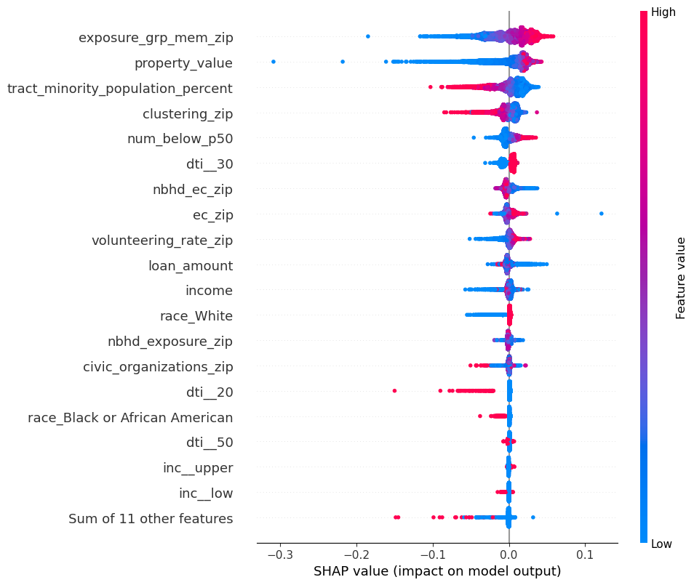
Model Explanation
MODEL 1 & 2
Feature Importance Evaluation
The SHAP explainer was used to review the impact of features on the output of the two XGBoost Regressor models (model 1 & model 2). A number of the Social Capital data ranked highly in feature importance, meaning they had a high impact on the predictions.
Exposure to high income friends (exposure_grp_mem_zip) in particular had the highest positive impact on predictions. That is, when a loan application was for a property in a Census tract where residents were exposed to more high income friends, the loan was more likely to be approved.
Economic exposure (ec_zip) had a fairly high impact on a concentrated number of predictions. Similar to the correlation matrix, clustering had a negative correlation.
For a small number of tracts where applicants were predominantly white, it had a concentrated positive impact. The opposite is true of Black applicant with a small concentration of negative impact.
SHAP beeswarm of feature importance from highest to lowest

Slide 11

Conclusion
We might be peripherally aware that our social network has an impact on future opportunites, but through this study, we can see that the existing social network of a home’s location can impact a lender’s chance of getting a home loan approved.
Extending on Opportunity Insight study, this analysis shows that economic connectedness and exposure to high income friends not only reinforces the social network patterns in place but can also be a barrier to entry for someone looking to buy into that community.

Slide 12

Learning Outcomes
Exposure to end to end regression model development, validation and testhing method
Application of new libraries such as XGBoost, Ray Tune and AutoGluon
Growing Mastery
Find data for home mortgage lenders who moved across different geographic locations
Investigate how segregation and redlining overlaps with current study
Giving Back
Contribute to initiatives or projects by bonding qualitative and quantitative research
Enrich communities of practice by making ML practices accessible

Slide 13

Thank you.
Bic Vu
AI Guild Apprentice Program
Cohort 11 | June 2023
ngvu@deloitte.com

Slide 14
Data Notes
DOCUMENTATION
About the HMDA data
Source: CFPB
Year: 2021
About the Social Capital data
Source: Social Capital Study
Year: 2022
Population: US
Geographic granularity: Census Tract
Population: US, Facebook users
Geographic granularity: Zip code
HMDA data dictionary
Social Capital Study Data
Metric | Defintion | Note
approval | Percent of approved vs denied applications in a census tract | Derived from “action_taken”
census_tract | US Census tract
derived_race | Single aggregated race categorization derived from applicant/borrower and co-applicant/co-borrower race fields
action_taken | The action taken on the covered loan or application | Filtered for: 1-loan originated 3 - application denied
loan_amount | The amount of the covered loan, or the amount applied for
property_value | The value of the property securing the covered loan or, in the case of an application, proposed to secure the covered loan, relied on in making the credit decision
income | The gross annual income, in thousands of dollars, relied on in making the credit decision, or if a credit decision was not made, the gross annual income relied on in processing the application
debt_to_income_ratio | The ratio, as a percentage, of the applicant’s or borrower’s total monthly debt to the total monthly income relied on in making the credit decision | Binned into categories
tract_minority_ population_percent | Percent of census tract that is a minority population
tract_to_msa_income_ percentage | Percentage of tract median family income compared to MSA/MD median family income | Binned into low, middle, high
Metric | Defintion
ec_zip | Economic connectedness (EC) – The degree to which low-income and high-income people are friends with each other. Economic Connectedness: two times the share of high-SES (high income) friends among low-SES (low income) individuals, averaged over all low-SES individuals in the ZIP code.
nbhd_ec_zip | Economic connectedness calculated using only within-neighborhood friends.
ec_grp_mem_zip | Two times the share of high-SES friends among low-SES individuals averaged over all low-SES individuals in the ZIP code.
exposure_grp_mem_zip | The share of high-income people in the Facebook groups in which people participate. Mean exposure to high-SES individuals by ZIP code for low-SES individuals: two times the average share of high-SES individuals in individuals’ groups, averaged over low-SES users.
clustering_zip | The average fraction of an individual’s friend pairs who are also friends with each other. A metric of Cohesiveness: The degree to which social networks are fragmented into cliques
volunteering_rate_zip | The percentage of Facebook users who are members of a group which is predicted to be about ‘volunteering’ or ‘activism’ based on group title and other group characteristics. A measure of of Civic Engagement: Rates of volunteering and participation in community organizations
civic_organization_zip | The number of Facebook Pages predicted to be “Public Good” pages based on page title, category, and other page characteristics, per 1,000 users in the ZIP code. A measure of Civic Engagement.
num_below_p50 | Number of children with below-national-median parental household income.

Slide 15
XGBoost Regressor
MODEL 1
[0] validation_0-rmse:0.23590
[1] validation_0-rmse:0.16956
[2] validation_0-rmse:0.12459
[3] validation_0-rmse:0.09486
[4] validation_0-rmse:0.07578
[5] validation_0-rmse:0.06397
[6] validation_0-rmse:0.05704
[7] validation_0-rmse:0.05332
[8] validation_0-rmse:0.05112
[9] validation_0-rmse:0.05001
[10] validation_0-rmse:0.04938
[11] validation_0-rmse:0.04897
[12] validation_0-rmse:0.04876
[13] validation_0-rmse:0.04854
[14] validation_0-rmse:0.04836
[15] validation_0-rmse:0.04825
[16] validation_0-rmse:0.04829
[17] validation_0-rmse:0.04814
[18] validation_0-rmse:0.04811
[19] validation_0-rmse:0.04805
[20] validation_0-rmse:0.04800
[21] validation_0-rmse:0.04795
[22] validation_0-rmse:0.04798
[23] validation_0-rmse:0.04795
[24] validation_0-rmse:0.04789
[25] validation_0-rmse:0.04778
[26] validation_0-rmse:0.04775
[27] validation_0-rmse:0.04768
[28] validation_0-rmse:0.04765
[29] validation_0-rmse:0.04765
[30] validation_0-rmse:0.04761
[31] validation_0-rmse:0.04761
[32] validation_0-rmse:0.04758
[33] validation_0-rmse:0.04760
[34] validation_0-rmse:0.04754
[35] validation_0-rmse:0.04754
[36] validation_0-rmse:0.04754
[37] validation_0-rmse:0.04754
[38] validation_0-rmse:0.04755
[39] validation_0-rmse:0.04759
[40] validation_0-rmse:0.04760
[41] validation_0-rmse:0.04756
[42] validation_0-rmse:0.04751
[43] validation_0-rmse:0.04751
[44] validation_0-rmse:0.04749
[45] validation_0-rmse:0.04745
[46] validation_0-rmse:0.04738
[47] validation_0-rmse:0.04738
[48] validation_0-rmse:0.04736
[49] validation_0-rmse:0.04738
[50] validation_0-rmse:0.04738
[51] validation_0-rmse:0.04732
[52] validation_0-rmse:0.04721
[53] validation_0-rmse:0.04725
[54] validation_0-rmse:0.04724
[55] validation_0-rmse:0.04722
[56] validation_0-rmse:0.04721
[57] validation_0-rmse:0.04720
[58] validation_0-rmse:0.04724
[59] validation_0-rmse:0.04723
[60] validation_0-rmse:0.04728
[61] validation_0-rmse:0.04735
[62] validation_0-rmse:0.04736
[63] validation_0-rmse:0.04735
[64] validation_0-rmse:0.04734
[65] validation_0-rmse:0.04731
[66] validation_0-rmse:0.04732
[67] validation_0-rmse:0.04734
Code snippet
model = XGBRegressor(
n_estimators=300,
max_depth = 5,
random_state = seed,
early_stopping_rounds=10
)
model = model.fit(X_train, y_train, eval_set=[(X_val, y_val)])

Slide 16
XGBoost Regressor with Ray Tune
MODEL 2
Code snippet
[0] validation_0-rmse:0.23443
[1] validation_0-rmse:0.16778
[2] validation_0-rmse:0.12254
[3] validation_0-rmse:0.09210
[4] validation_0-rmse:0.07235
[5] validation_0-rmse:0.06027
[6] validation_0-rmse:0.05334
[7] validation_0-rmse:0.04941
[8] validation_0-rmse:0.04708
[9] validation_0-rmse:0.04585
[10] validation_0-rmse:0.04525
[11] validation_0-rmse:0.04492
[12] validation_0-rmse:0.04468
[13] validation_0-rmse:0.04448
[14] validation_0-rmse:0.04436
[15] validation_0-rmse:0.04431
[16] validation_0-rmse:0.04424
[17] validation_0-rmse:0.04431
[18] validation_0-rmse:0.04431
[19] validation_0-rmse:0.04431
[20] validation_0-rmse:0.04435
[20] validation_0-rmse:0.04435
[21] validation_0-rmse:0.04439
[22] validation_0-rmse:0.04425
[23] validation_0-rmse:0.04424
[24] validation_0-rmse:0.04429
[25] validation_0-rmse:0.04430
[26] validation_0-rmse:0.04429
[27] validation_0-rmse:0.04426
[28] validation_0-rmse:0.04427
[29] validation_0-rmse:0.04427
[30] validation_0-rmse:0.04419
[31] validation_0-rmse:0.04417
[32] validation_0-rmse:0.04420
[33] validation_0-rmse:0.04419
[34] validation_0-rmse:0.04424
[35] validation_0-rmse:0.04423
[36] validation_0-rmse:0.04427
[37] validation_0-rmse:0.04425
[38] validation_0-rmse:0.04419
[39] validation_0-rmse:0.04424
[40] validation_0-rmse:0.04424
model = XGBRegressor(
n_estimators=300,
max_depth = 6,
random_state = seed,
early_stopping_rounds=10
)
model = model.fit(X_train, y_train, eval_set=[(X_val, y_val)])
Best model validation RMSE: 0.04585943734212902
Best model parameters: { 'objective': 'reg:squarederror’,
'eval_metric': 'rmse’,
'n_estimators': 300,
'max_depth': 6,
'colsample_bytree': 0.8171484335790162,
'lambda': 0.6673997656918179,
'alpha': 0.03305586345304068}

Slide 17
AutoGluon
MODEL 3
Code snippet
from autogluon.tabular import TabularDataset, TabularPredictor
target = "approval"
metric = "rmse"
excluded_models = ['NN_TORCH', 'CAT', 'RF', 'FASTAI']
predictor = TabularPredictor(label=target).fit(
train_data=df_train,
excluded_model_types=excluded_models,
time_limit=120,
verbosity= 2,
presets='best_quality’)
predictor.leaderboard(df_test, silent=True)
predictor.evaluate(df_test)
Best model: 'WeightedEnsemble_L3'
{'root_mean_squared_error': -0.03985582016238834,
'mean_squared_error': -0.001588486400816641, 'mean_absolute_error': -0.02876924000518339,
'r2': 0.7070154319401782,
'pearsonr': 0.8409075687940584,
'median_absolute_error': -0.021410344963759487}

